Slide 1
GO PARKING
You made the right Choice!!!
Team Innovators:
Moin, Syed
Chakilam , Revanth
Nandigam, Nageswara
Sarda, Devender

Slide 2
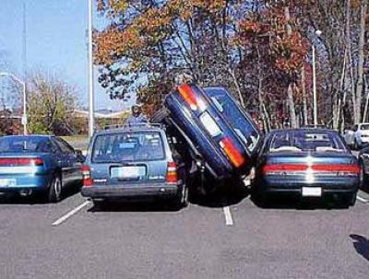
Why ?
In today’s digital era where everything is online …Why waste time finding a parking spot for your vehicle on the destination ? when you can reserve the spot in one touch from your home. That’s where GO PARKING comes into picture.

Slide 3
Application Features
GO PARKING is an online web application portal where user can search and reserve any place for parking his/her Vehicle and the application results with a wide range of locations and prices on hourly basis.
User can create account or use OAuth (Facebook and Google) to sign in to the app.
The application provides two user friendly layouts. One with the map view which highlights the location pointers. The other is the list view where it provides list of all the location with the details.
Users can reserve a parking spot with their priority timings and providing vehicle registration number
Application triggers an email notification to user on successful registration.
User can delete his parking reservations or account.

Slide 4
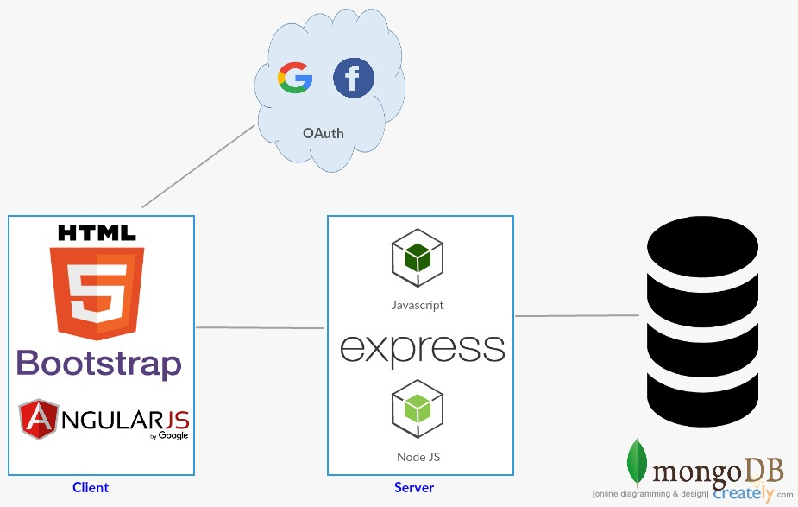
System Architecture
Technologies: MEAN Stack, jQuery, Bootstrap, Google Maps, Amazon Web services

Slide 5
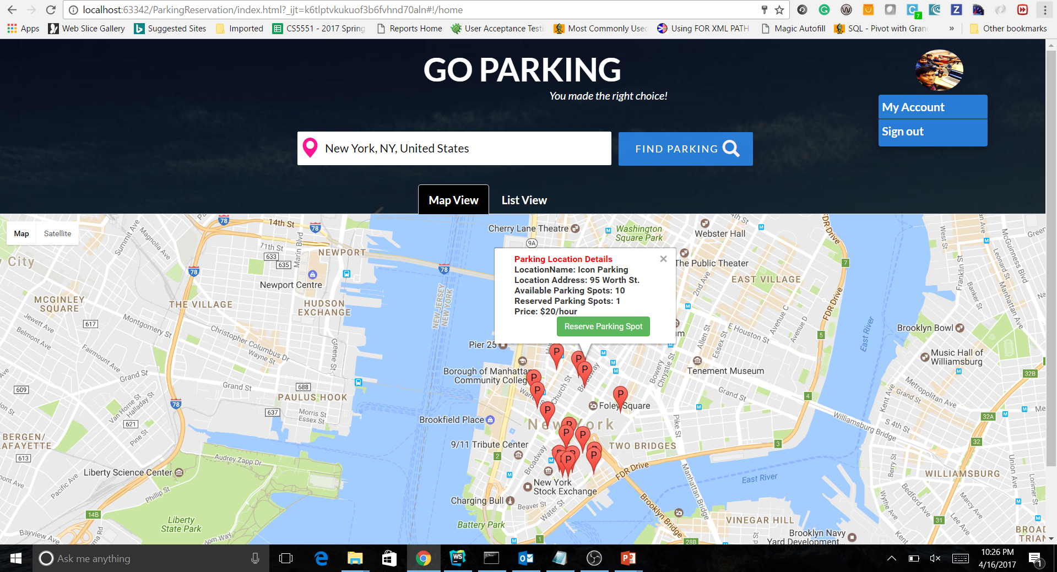
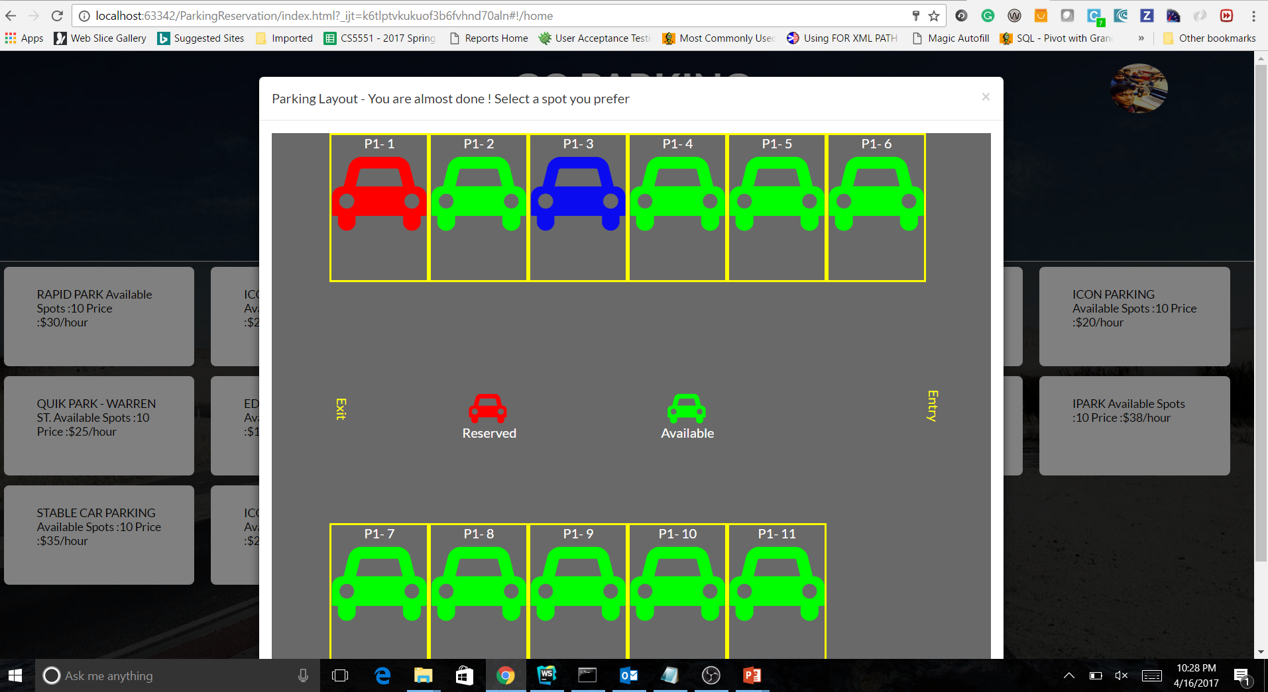
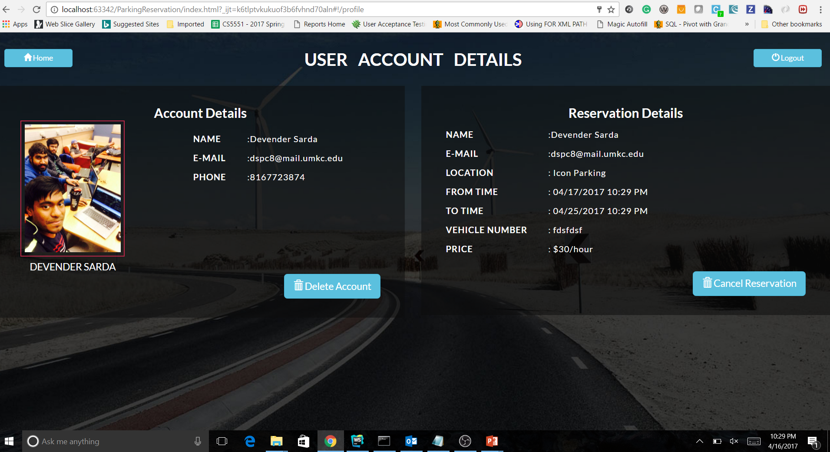
Application User Interface
Map Layout
Parking Layout
User Account Page

Slide 6
Future scope of development
Integration of payment gateway
Scaling it to multi-story parking with 3D view
Expanding to more locations
References
https://www.w3schools.com
https://developers.google.com/maps/
https://angularjs.org
https://mlab.com/
https://nodejs.org/en/

